Slide 1
Kubernetes & Minikube
Brian Hatfield
August 18, 2021

Slide 2
Outline
Kubernetes
Minikube
Demonstration

Slide 3
Kubernetes, why?
Application deployment platform
Containers
Isolation
Dependency and version management
Component re-use (microservices)
High availability (clustering)
Scalability (5000 nodes)
Load balancing
Storage orchestration (e.g. block, file, cloud)
Rolling updates
Self-healing

Slide 4
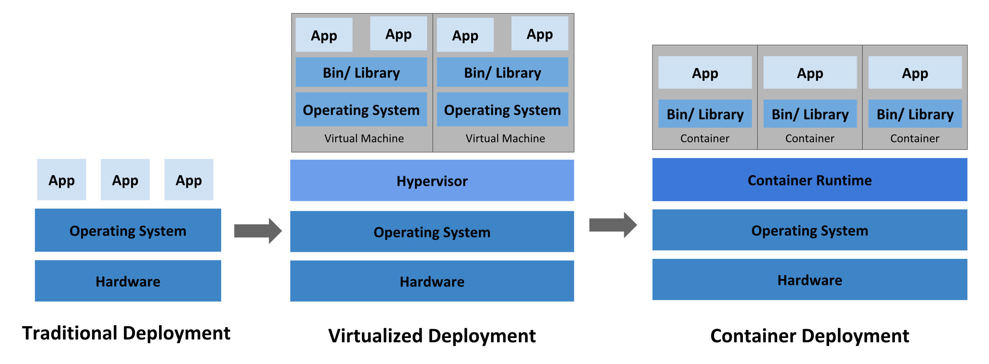
Container evolution

Slide 5
Minikube
A virtual cluster for developing on kubernetes
runs on laptop: Linux, Windows, macOS
Don’t need to: procure servers, networking, define VMs, get fyre access
One or more nodes
Alternatives:
kind (Kubernetes-IN-Docker) – Kubernetes uses
CRC (CodeReady Containers) – OpenShift
Microk8s - Canonical
k3d – Rancher Labs

Slide 6
Minikube node isolation “drivers”:
All platforms:
Docker
VirtualBox
SSH (user-supplied VM)
Linux only:
kvm2
None (user-supplied VM)
Podman
macOS only:
Hyperkit
Parallels
Windows only:
Hyper-V

Slide 7
Demonstration
minikube start, stop, delete, profile, image
kubectl apply, get, delete, edit, scale, create, logs, describe
pod
deployment
persistent volume
docker/podman build, run, save

Slide 8
Thank you
kubernetes.io
https://kubernetes.io/docs/concepts/overview/what-is-kubernetes/
https://kubernetes.io/docs/tutorials/hello-minikube/
minikube.sigs.k8s.io
https://minikube.sigs.k8s.io/docs/start/
github.com
https://github.com/hatfieldbrian/kube-demo
https://github.com/RamenDR

Slide 9
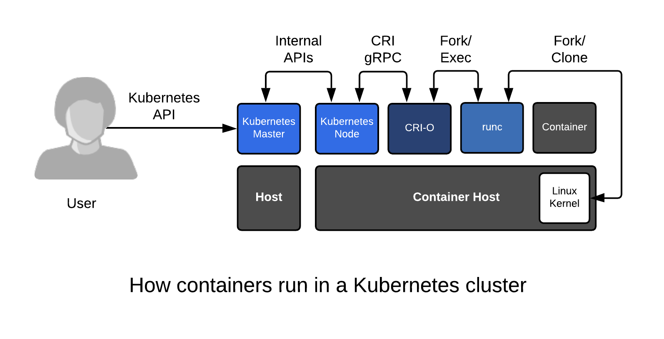
Kubernetes container runtimes:
CRI (container runtime interface) implementations:
CRI-O
cri-containerd
dockershim

Slide 10
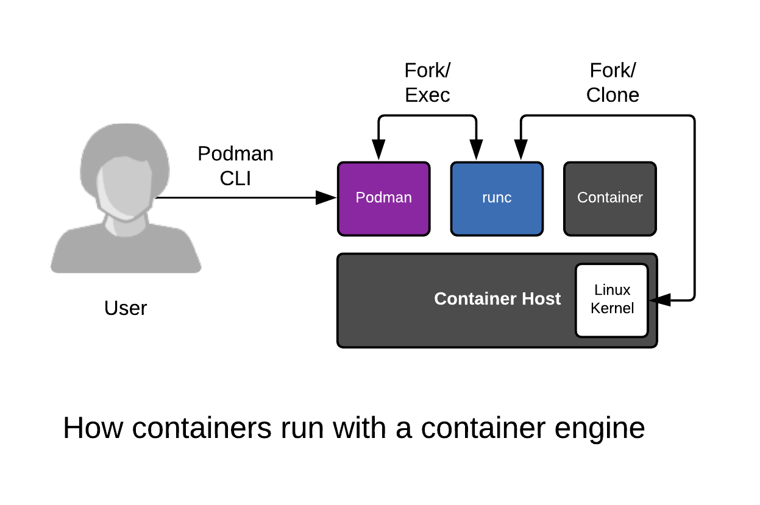
Open Container Initiative
runC

